Slide 1

E.G.S. Pillay Engineering College
An Autonomous Institution Affiliated to Anna University, Chennai | Approved by AICTE, New Delhi
Accredited by NAAC with A++ Grade | Accredited by NBA T1 (B.E. – CIVIL,MECH,EEE,CSE,ECE & B.Tech – IT)
Old Nagore Road, Thethi, Nagore Village, Nagapattinam – 611002, Tamil Nadu, India
INFORMATION TECHNOLOGY
CLOUD COMPUTTING
Date& Session : &AN
Venue: SJB
Presented by,
NANTHAKUMAR.K

Slide 2

Outline of the Presentation
Abstract
Introduction
Literature reviews
Need for the study
Problem statement & Objectives
Methodology Flowchart
Results (If implemented)
References
NOTE : Get your presentation file verified by your guide before seminar ,well in advance, so that necessary changes can be incorporated.
Date Register Number of the Student

Slide 3
result
Cloud computing reduces the need for expensive hardware and maintenance.
It allows users to access data and applications from anywhere using the internet.
Scalability helps organizations easily increase or decrease resources as needed.
Data backup and recovery are faster and more reliable in the cloud.
Cloud computing improves collaboration and efficiency for users and businesses.

Slide 4
Need of study
High Demand in Industry – Cloud computing skills are widely required by IT companies today.
Cost Efficiency – Reduces the need for expensive hardware and software by using online services.
Scalability – Resources like storage and computing power can be increased or decreased easily.
Anywhere Access – Data and applications can be accessed from any place with an internet connection.
Supports Modern Technologies – Essential for AI, Big Data, IoT, and machine learning applications.
Improved Data Security – Cloud providers offer advanced security, backup, and recovery features.

Slide 5
Abstract
Cloud computing is the delivery of computing services (like storage, servers, databases, and software) over the internet, allowing users to access and use these resources from anywhere without managing physical infrastructure themselves.
It enables on-demand access, scalability, and cost savings because users only pay for what they use and can scale resources as needed
Date Register Number of the Student
5/13

Slide 6
Introduction
Background-
Cloud computing is the delivery of computing services like storage, software, and processing power over the internet, allowing users to access resources on demand without owning or managing physical hardware themselves
Need for the Project-
Cloud computing is needed because it allows organizations and individuals to access and scale computing resources and services over the internet quickly and cost-effectively, without the need to own or maintain physical hardware
Scope of the Project
This presentation covers the fundamentals of cloud computing, its evolution, service and deployment models, advantages, and applications, preparing the audience for further exploration in cloud-related areas.
Cloud computing is a technology that allows you to access and use computing resources like storage, software, and servers over the internet on demand, without needing to own or manage physical hardware
Date Register Number of the Student

Slide 7
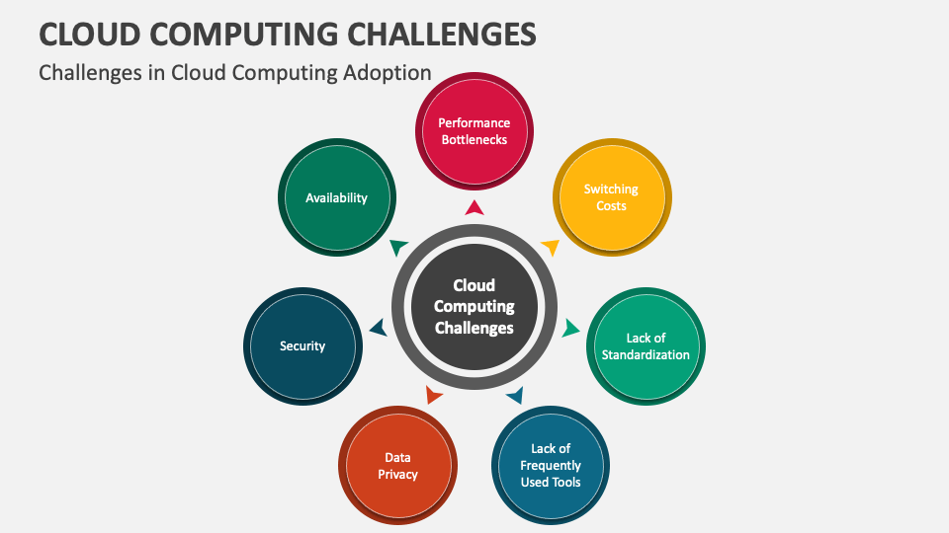
Sample: Problem statement
Date Register Number of the Student

Slide 8
Literature Review ( Most imp. Section at this seminar)
Literature Review
Cloud Computing Adoption Issues: Studies show enterprises face both internal (management experience, resources) and external challenges (regulations, standards) before adopting cloud computing.
Benefits Identified: Research highlights cloud’s cost efficiency, scalability, agility, and accessibility as major advantages for organizations of all sizes.
Common Challenges: Key issues include security risks, privacy concerns, interoperability difficulties, network dependency, and skill shortages.
Research Trends: Future work focuses on enhancing cloud governance, security frameworks, service quality, and overcoming adoption barriers through innovative architectures.
Applications: Cloud computing is increasingly applied across various domains such as healthcare (eHealth), education, and business analytics, driving digital transformation.
Date Register Number of the Student

Slide 9
Gap Identification/Problem Definition
Security Concerns: Despite advances, cloud security remains a top concern with rising threats like AI-driven attacks and quantum computing risks.
Multi-Cloud Complexity: Organizations are increasingly adopting multi-cloud and hybrid cloud strategies, but lack of standardization complicates management and interoperability.
Skill Shortage: There is an ongoing shortage of skilled professionals proficient in cloud architecture, DevOps, and cloud security, slowing adoption.
Cost & Resource Optimization: Many organizations struggle to control and optimize cloud costs effectively, leading to resource waste.
Edge & Cloud Integration: Growing demand for edge computing requires seamless integration with cloud platforms, which is still a challenge.
Governance & Compliance: Ensuring compliance with regulatory frameworks and data sovereignty laws across diverse jurisdictions remains an unsolved issue
Date Register Number of the Student

Slide 10
Methodology
Evaluate Current Infrastructure and Workflows Assess existing IT systems, applications, and services to identify what can be migrated and optimized in the cloud.
Define Business Objectives Set goals like cost reduction, scalability, improved accessibility, or enhanced collaboration that the cloud solutions should meet.
Choose Cloud Deployment and Service Models Select appropriate models (Public, Private, Hybrid Cloud; IaaS, PaaS, SaaS) based on business needs and data sensitivity.
Date Register Number of the Student

Slide 11
Methodology
Plan Migration Strategy Decide migration approach:
Rehost (Lift and Shift): Move applications as-is to the cloud.
Refactor: Modify applications to leverage cloud-native features.
Data Migration and Integration Plan for secure and smooth data transfer to the cloud, ensuring minimal downtime and data integrity.

Slide 12
References
Erl, Thomas, and Ricardo Puttini. Cloud Computing: Concepts, Technology & Architecture. Prentice Hall, 2013.
Hurwitz, Judith, et al. Cloud Computing For Dummies. Wiley, 2012.
Bhowmik, Sandeep. Cloud Computing. Cambridge University Press, 2017.
Note: This structure of ppt is designed with specific projects in mind. Kindly note that ,this is not theonly Standard Format. Format will vary according to nature of projects.
Date Register Number of the Student

Slide 13
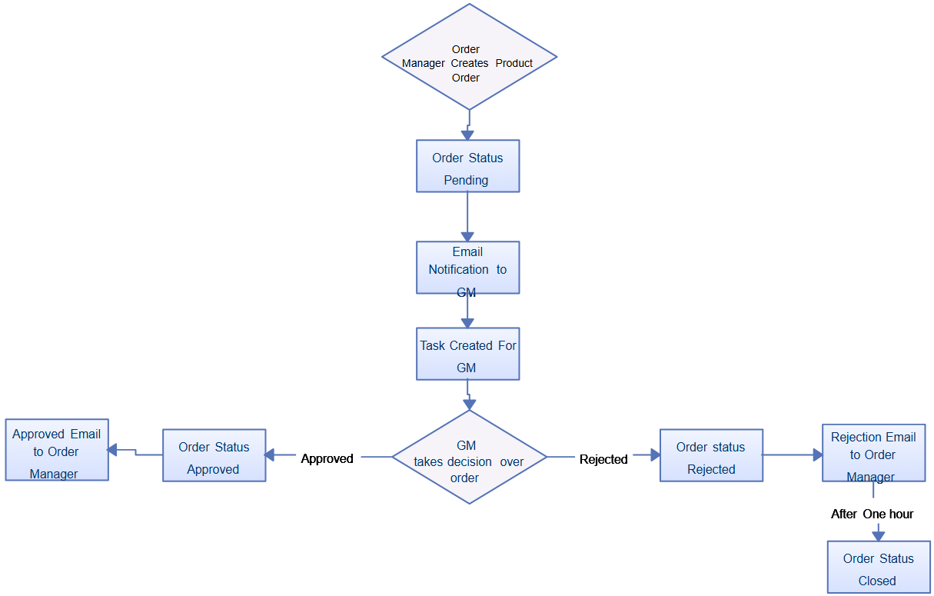
Sample : Methodology Flowchart
Date Register Number of the Student

